Slide 1
AGENDA
Operation Analytics and Investigating Metric Spike
PROJECT DESCRIPTION
TECH STACK USED
APPROACH TASKS
CONCLUSION

Slide 2
PROJECT DESCRIPTION
This project analyzes job data and investigates metric spikes to improve a company’s operations. Operation Analytics and Investigating Metric Spike aims to implement an analytics system to monitor and analyze key performance metrics within a specified environment he system will use real-time data collection and analysis techniques to identify and investigate sudden spikes or anomalies in the metrics, such as user engagement, retention rates and workflow optimizations. The insights gained from this project will help in understanding operational efficiency, detecting potential issues, and taking proactive measures to optimize performance and ensure a smooth operation.
TECH STACK USED
In this project I'm using Tech-Stack
MYSQL workbench 8.0
MS POWER POINT

Slide 3
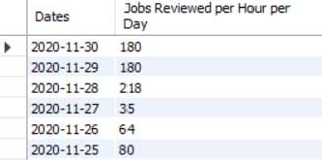
Case Study 1 (Job Data) 1. Calculate the number of jobs reviewed per hour per day for November 2020? SELECT ds AS Dates, ROUND((COUNT(job_id)/SUM(time_spent))*3600) AS "Jobs Reviewed per Hour per Day" FROM job_data WHERE ds BETWEEN '2020-11-01' AND '2020-11-30' GROUP BY ds; On date 2020-11-28 there is maximum number of jobs reviewed that is 218.

Slide 4

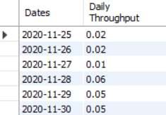
2. Calculate 7 day rolling average of throughput? For throughput, do you prefer daily metric or 7- day rolling and why? SELECT ROUND(COUNT(event)/SUM(time_spent), 2) AS "Weekly Throughput" FROM job_data; The weekly throughput is 0.03.
SELECT ds AS Dates, ROUND(COUNT(event)/SUM(time_spent), 2) AS "Daily Throughput" FROM job_data
GROUP BY ds ORDER BY ds;
On date 2020-11-28 the throughput is highest 0.06.

Slide 5
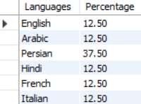
Metrics will always go up and down on a weekly and daily basis. You’ll get numbers faster every day or minute if you want. As a result, rolling metrics are superb at showing if your metrics are trending up or down on a daily level. 3. Calculate the percentage share of each language in the last 30 days? SELECT language AS Languages, ROUND(100 * COUNT(*)/total, 2) AS Percentage FROM job_data CROSS JOIN (SELECT COUNT(*) AS total FROM job_data) sub GROUP BY language; Persian language is highest with 37.5% total.
Answer:

Slide 6

4. Let’s say you see some duplicate rows in the data. How will you display duplicates from the table? SELECT actor_id, COUNT(*) AS Duplicates FROM job_data GROUP BY actor_id HAVING COUNT(*) > 1; Actor ID 1003 has duplicate rows.

Slide 7
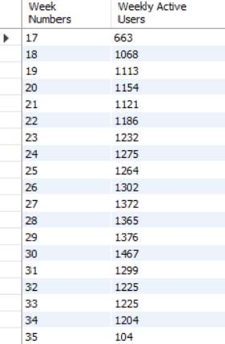
Case Study 2 (Investigating Metric Spike) 1. Calculate the weekly user engagement? SELECT EXTRACT(WEEK FROM occurred_at) AS "Week Numbers", COUNT(DISTINCT user_id) AS "Weekly Active Users" FROM events WHERE event_type = 'engagement' GROUP BY 1;

Slide 8
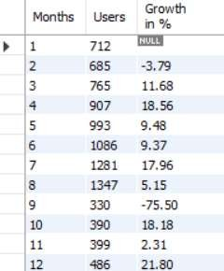
2. Calculate the user growth for product? SELECT Months, Users, ROUND(((Users/LAG(Users, 1) OVER (ORDER BY Months) - 1)*100), 2) AS "Growth in %" FROM ( SELECT EXTRACT(MONTH FROM created_at) AS Months, COUNT(activated_at) AS Users FROM users WHERE activated_at NOT IN("") GROUP BY 1 ORDER BY 1 ) sub;

Slide 9
3. Calculate the weekly retention of users-sign up cohort? SELECT first AS "Week Numbers", SUM(CASE WHEN week_number = 0 THEN 1 ELSE 0 END) AS "Week 0", SUM(CASE WHEN week_number = 1 THEN 1 ELSE 0 END) AS "Week 1", SUM(CASE WHEN week_number = 2 THEN 1 ELSE 0 END) AS "Week 2", SUM(CASE WHEN week_number = 3 THEN 1 ELSE 0 END) AS "Week 3", SUM(CASE WHEN week_number = 4 THEN 1 ELSE 0 END) AS "Week 4", SUM(CASE WHEN week_number = 5 THEN 1 ELSE 0 END) AS "Week 5", SUM(CASE WHEN week_number = 6 THEN 1 ELSE 0 END) AS "Week 6", SUM(CASE WHEN week_number = 7 THEN 1 ELSE 0 END) AS "Week 7", SUM(CASE WHEN week_number = 8 THEN 1 ELSE 0 END) AS "Week 8", SUM(CASE WHEN week_number = 9 THEN 1 ELSE 0 END) AS "Week 9", SUM(CASE WHEN week_number = 10 THEN 1 ELSE 0 END) AS "Week 10", SUM(CASE WHEN week_number = 11 THEN 1 ELSE 0 END) AS "Week 11", SUM(CASE WHEN week_number = 12 THEN 1 ELSE 0 END) AS "Week 12", SUM(CASE WHEN week_number = 13 THEN 1 ELSE 0 END) AS "Week 13",

Slide 10
SUM(CASE WHEN week_number = 14 THEN 1 ELSE 0 END) AS "Week 14“ , SUM(CASE WHEN week_number = 15 THEN 1 ELSE 0 END) AS "Week 15", SUM(CASE WHEN week_number = 16 THEN 1 ELSE 0 END) AS "Week 16", SUM(CASE WHEN week_number = 17 THEN 1 ELSE 0 END) AS "Week 17", SUM(CASE WHEN week_number = 18 THEN 1 ELSE 0 END) AS "Week 18", FROM ( SELECT m.user_id, m.login_week, n.first, m.login_week - first AS week_number FROM (SELECT user_id, EXTRACT(WEEK FROM occurred_at) AS login_week FROM events GROUP BY 1, 2) m, (SELECT user_id, MIN(EXTRACT(WEEK FROM occurred_at)) AS first FROM events GROUP BY 1) n WHERE m.user_id = n.user_id ) sub GROUP BY first ORDER BY first;

Slide 11
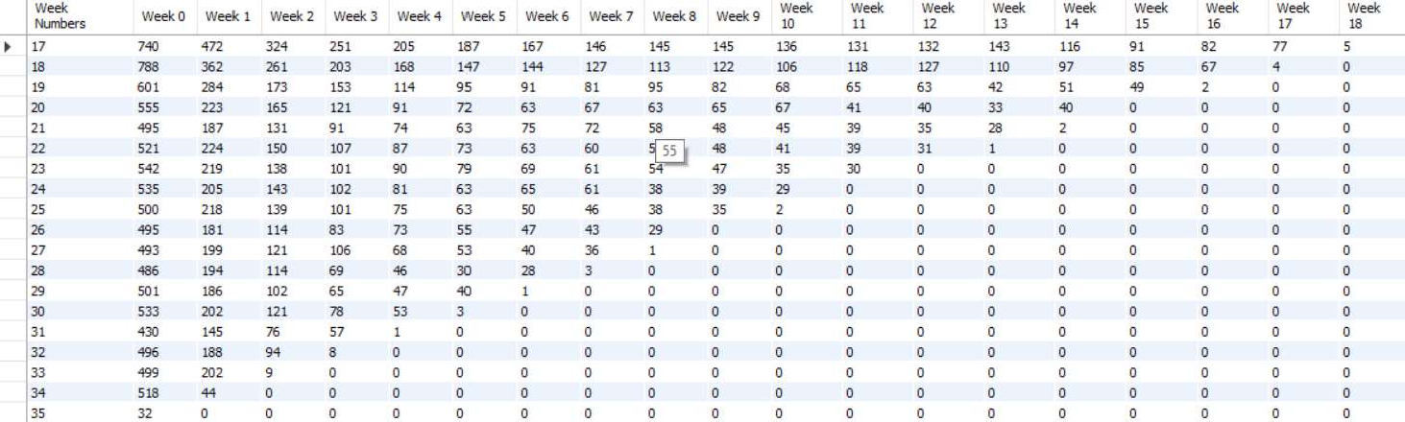

Slide 12
4. Calculate the weekly engagement per device? SELECT EXTRACT(WEEK FROM occurred_at) AS "Week Numbers", COUNT(DISTINCT CASE WHEN device IN('dell inspiron notebook') THEN user_id ELSE NULL END) AS "Dell Inspiron Notebook", COUNT(DISTINCT CASE WHEN device IN('iphone 5') THEN user_id ELSE NULL END) AS "iPhone 5", COUNT(DISTINCT CASE WHEN device IN('iphone 4s') THEN user_id ELSE NULL END) AS "iPhone 4S", COUNT(DISTINCT CASE WHEN device IN('windows surface') THEN user_id ELSE NULL END) AS "Windows Surface", COUNT(DISTINCT CASE WHEN device IN('macbook air') THEN user_id ELSE NULL END) AS "Macbook Air", COUNT(DISTINCT CASE WHEN device IN('iphone 5s') THEN user_id ELSE NULL END) AS "iPhone 5S", COUNT(DISTINCT CASE WHEN device IN('macbook pro') THEN user_id ELSE NULL END) AS "Macbook Pro", COUNT(DISTINCT CASE WHEN device IN('kindle fire') THEN user_id ELSE NULL END) AS "Kindle Fire",

Slide 13
COUNT(DISTINCT CASE WHEN device IN('ipad mini') THEN user_id ELSE NULL END) AS "iPad Mini", COUNT(DISTINCT CASE WHEN device IN('nexus 7') THEN user_id ELSE NULL END) AS "Nexus 7", COUNT(DISTINCT CASE WHEN device IN('nexus 5') THEN user_id ELSE NULL END) AS "Nexus 5", COUNT(DISTINCT CASE WHEN device IN('samsung galaxy s4') THEN user_id ELSE NULL END) AS "Samsung Galaxy S4", COUNT(DISTINCT CASE WHEN device IN('lenovo thinkpad') THEN user_id ELSE NULL END) AS "Lenovo Thinkpad", COUNT(DISTINCT CASE WHEN device IN('samsumg galaxy tablet') THEN user_id ELSE NULL END) AS "Samsumg Galaxy Tablet", COUNT(DISTINCT CASE WHEN device IN('acer aspire notebook') THEN user_id ELSE NULL END) AS "Acer Aspire Notebook", COUNT(DISTINCT CASE WHEN device IN('asus chromebook') THEN user_id ELSE NULL END) AS "Asus Chromebook", COUNT(DISTINCT CASE WHEN device IN('htc one') THEN user_id ELSE NULL END) AS "HTC One", COUNT(DISTINCT CASE WHEN device IN('nokia lumia 635') THEN user_id ELSE NULL END) AS "Nokia Lumia 635", COUNT(DISTINCT CASE WHEN device IN('samsung galaxy note') THEN user_id ELSE NULL END) AS "Samsung Galaxy Note",

Slide 14
COUNT(DISTINCT CASE WHEN device IN('acer aspire desktop') THEN user_id ELSE NULL END) AS "Acer Aspire Desktop", COUNT(DISTINCT CASE WHEN device IN('mac mini') THEN user_id ELSE NULL END) AS "Mac Mini", COUNT(DISTINCT CASE WHEN device IN('hp pavilion desktop') THEN user_id ELSE NULL END) AS "HP Pavilion Desktop", COUNT(DISTINCT CASE WHEN device IN('dell inspiron desktop') THEN user_id ELSE NULL END) AS "Dell Inspiron Desktop", COUNT(DISTINCT CASE WHEN device IN('ipad air') THEN user_id ELSE NULL END) AS "iPad Air",

Slide 15
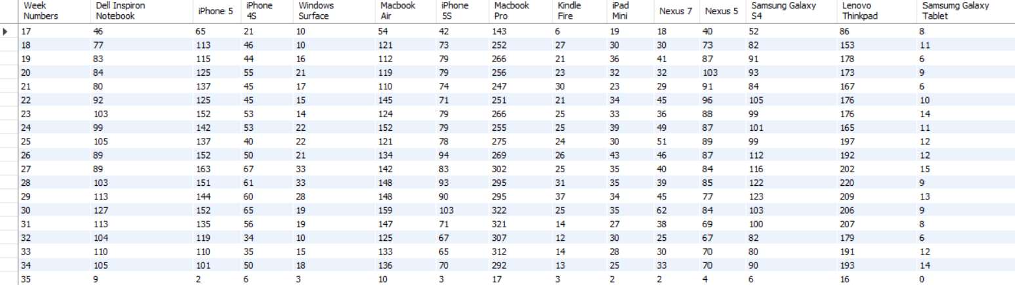
COUNT(DISTINCT CASE WHEN device IN('amazon fire phone') THEN user_id ELSE NULL END) AS "Amazon Fire Phone", COUNT(DISTINCT CASE WHEN device IN('nexus 10') THEN user_id ELSE NULL END) AS "Nexus 10" FROM events WHERE event_type = 'engagement' GROUP BY 1 ORDER BY 1 ;

Slide 16
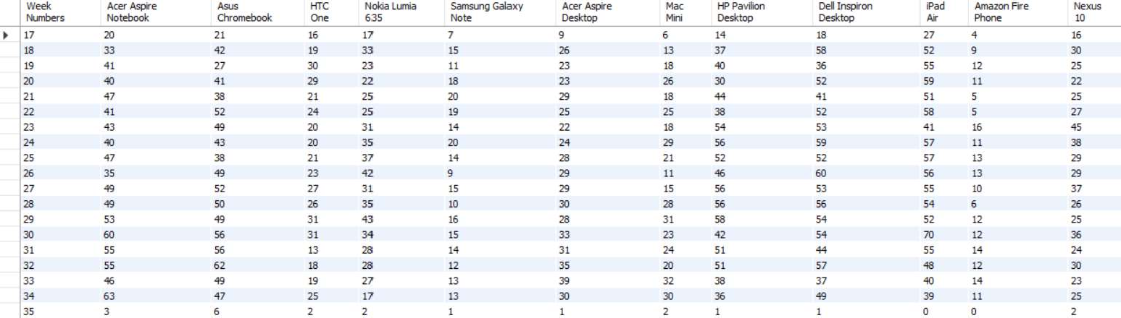

Slide 17
5. Calculate the email engagement metrics? SELECT Week, ROUND((weekly_digest/total*100),2) AS "Weekly Digest Rate", ROUND((email_opens/total*100),2) AS "Email Open Rate", ROUND((email_clickthroughs/total*100),2) AS "Email Clickthrough Rate", ROUND((reengagement_emails/total*100),2) AS "Reengagement Email Rate" FROM ( SELECT EXTRACT(WEEK FROM occurred_at) AS Week, COUNT(CASE WHEN action = 'sent_weekly_digest' THEN user_id ELSE NULL END) AS weekly_digest, COUNT(CASE WHEN action = 'email_open' THEN user_id ELSE NULL END) AS email_open,

Slide 18
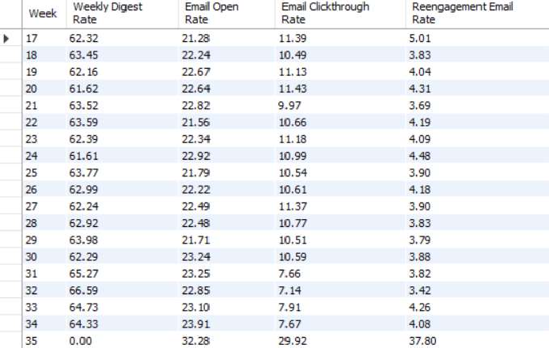
COUNT(CASE WHEN action = 'email_clickthrough' THEN user_id ELSE NULL END) AS email_clickthroughs, COUNT(CASE WHEN action = 'sent_reengagement_email' THEN user_id ELSE NULL END) AS reengagement_emails, COUNT(user_id) AS total FROM email_events GROUP BY 1 ) sub GROUP BY 1 ORDER BY 1;

Slide 19
CONCLUSION
Real-Time Analytics: The implemented analytics system effectively processed incoming data in real-time, enabling timely monitoring of key performance metrics. This real-time capability allowed for prompt detection of any unusual spikes or anomalies in the metrics.
Metric Spike Detection: The system demonstrated its ability to accurately identify and flag sudden spikes in metrics. This capability enabled quick detection of potential issues or opportunities that required further investigation.
Operational Optimization: Armed with the insights gained from the project, the organization was able to optimize its operations, address performance bottlenecks, and improve overall efficiency.
Proactive Measures: The project's findings enabled the organization to take proactive measures to prevent potential issues and anticipate future spikes, resulting in improved reliability and user experience.

